Slide 1
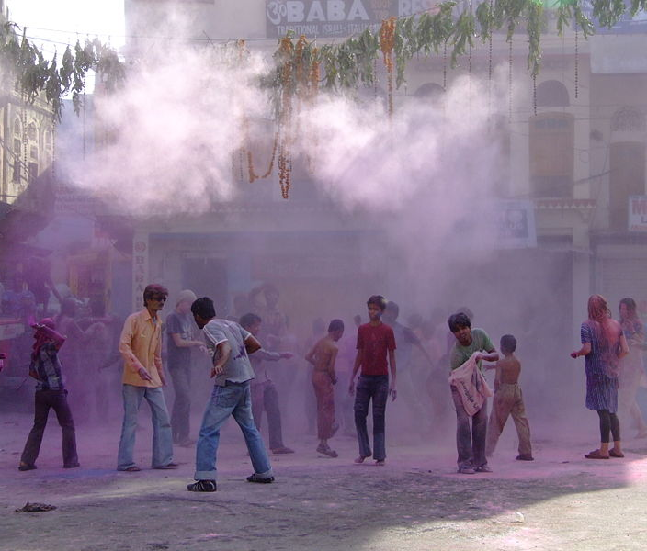
Holi-The Festival Of Colors

Slide 2
Why do we celebrate Holi?
The festival of Holi can be regarded as a celebration of the Colors of Unity & Brotherhood - an opportunity to forget all differences and indulge in simple fun.
It is one occasion when sprinkling colored powder ('gulal') or colored water on each other breaks all barriers of discrimination so that everyone looks the same and universal brotherhood is reaffirmed.

Slide 3
Welcome Spring
It is celebrated as harvest festival as well as welcome-festival for the spring season in India.
What is 'Phagwah'?
'Phagwah' is derived from the name of the Hindu month 'Phalgun', because it is on the full moon in the month of Phalgun that Holi is celebrated. The month of Phalgun ushers Spring in India ,when seeds sprout, flowers bloom and the country rises from winter's slumber.

Slide 4
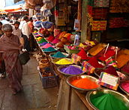
Let's learn more about its history and significance...

Slide 5
Meaning of the Word “HOLI”
'Holi' comes from the word 'hola', meaning to offer prayer to the Almighty as Thanksgiving for good harvest.
Holi is celebrated every year to remind people that those who love God shall be saved and they who torture the devotee of God shall be reduced to ashes.
Bonfires are lit on the eve of the festival, also known as Holika Dahan (burning of Holika) or Chhoti Holi (little Holi).

Slide 6
Legend of Hollika
Holika was the sister of demon-king Hiranyakashipu. Holika had a boon to remain unburned even inside fire.
The demon-king punished his son, Prahlad in a variety of ways to denounce Lord Narayana. He failed in all his attempts.
Finally, he asked his sister Holika to take Prahlad in her lap and enter a blazing fire .Holika did her brother's bidding.
However, Holika's boon ended by this act of supreme sin against the Lord's devotee and was burnt to ashes.
But Prahlad came out unharmed.

Slide 7
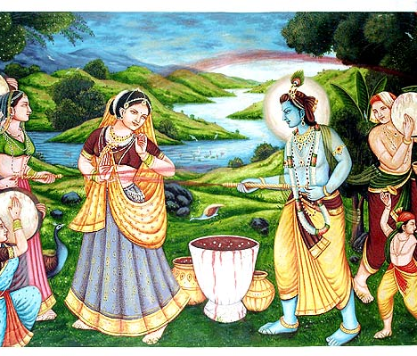
The Lord Krishna connection...

Slide 8
Once when Shri Krishna was a little boy, he was very upset and came to his Mom and asked her,” Why is Radha so fair skinned and my skin so dark?”
Yashoda Maiya laughed and answered, “ Don’t worry my Dear Krishna, take some color powder and put on Radha’s face and also on your own. Then no one can tell the difference between the two of you.”

Slide 9
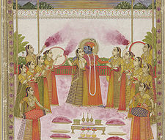
Raslila
Holi is also associated with the Divine Dance known as Raaslila staged by Lord Krishna for the benefit of his devotees of Vrindavan commonly known as Gopis.

Slide 10
Traditional Holi Celebration
The spring season, during which the weather changes, is believed to cause viral fever and cold. The playful throwing of natural colored powders has a medicinal significance: the colors are traditionally made of Neem, Kumkum, Haldi, Bilva, and other medicinal herbs prescribed by Āyurvedic doctors.
A special drink called thandai is prepared (commonly made of almonds, pistachios, rose petals, etc.),.
For wet colors, traditional flowers of Palash are boiled and soaked in water over night to produced yellow colored water, which also had medicinal properties. Unfortunately the commercial aspect of celebration has led to an increase in the use of synthetic colors, which in some cases, may be toxic.

Slide 11
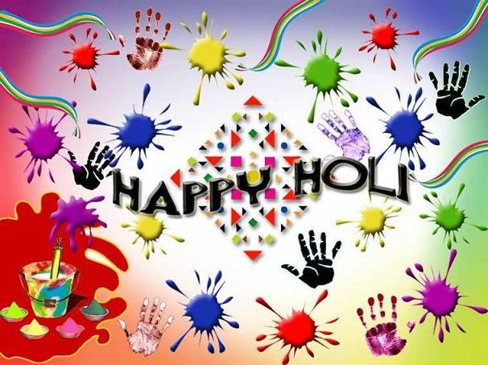
HAPPY HOLI!
It is believed that the combination of different colors played at this festival take all the sorrow away and make life itself more colorful.

